Slide 1
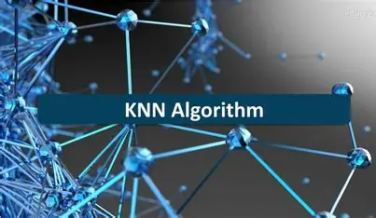
KNN ALGORITHM IN MACHINE LANGUAGE
Dr Ashok Gopalakrishnan
Scientist Emeritus

Slide 2
KNN ALGORITHM IN MACHINE LANGUAGE
The K-Nearest Neighbors (KNN) algorithm is a supervised machine learning technique used for both classification and regression tasks. It operates on the principle of proximity, predicting the output for a new data point based on the labels or values of its nearest neighbors in the training dataset.
Key Characteristics of KNN
Lazy Learning: KNN does not involve a training phase. Instead, it stores the entire dataset and performs computations only during prediction.
Non-Parametric: It makes no assumptions about the underlying data distribution, making it versatile for various datasets.
What Is Lazy Learning?
Lazy learning means the algorithm doesn’t learn from the data until it’s asked to make a prediction. It’s like a student who doesn’t study before the exam but quickly looks up answers when the test starts.

Slide 3
KNN ALGORITHM IN MACHINE LANGUAGE
The K-Nearest Neighbors (KNN) algorithm is a supervised machine learning technique used for both classification and regression tasks. It operates on the principle of proximity, predicting the output for a new data point based on the labels or values of its nearest neighbors in the training dataset.
Key Characteristics of KNN
Lazy Learning: KNN does not involve a training phase. Instead, it stores the entire dataset and performs computations only during prediction.
Non-Parametric: It makes no assumptions about the underlying data distribution, making it versatile for various datasets.
How It Works
In lazy learning, the model stores all training data instead of building a general rule or formula. When a new query comes, it searches through the stored data to find examples that are most similar. The prediction is made on the spot, using those examples.
(Lazy Learning)

Slide 4
KNN ALGORITHM IN MACHINE LANGUAGE
Key Characteristics of KNN
Lazy Learning: KNN does not involve a training phase. Instead, it stores the entire dataset and performs computations only during prediction.
Non-Parametric: It makes no assumptions about the underlying data distribution, making it versatile for various datasets.
KNN as a Lazy Learner
KNN doesn’t build a mathematical model during training.
It simply keeps the dataset and waits for a new data point.
When asked to predict, it calculates distances to all known points and decides based on the nearest neighbors.
So, learning happens at prediction time, not before.

Slide 5
KNN ALGORITHM IN MACHINE LANGUAGE
Key Characteristics of KNN
Lazy Learning: KNN does not involve a training phase. Instead, it stores the entire dataset and performs computations only during prediction.
Non-Parametric: It makes no assumptions about the underlying data distribution, making it versatile for various datasets.
Analogy for Students
Imagine you have a library full of solved problems:
You don’t memorize formulas.
When a new question appears, you flip through the library to find similar problems and copy the solution pattern. That’s exactly how
KNN behaves — lazy but effective when the library is well‑organized.

Slide 6
KNN ALGORITHM IN MACHINE LANGUAGE
Key Characteristics of KNN
Lazy Learning: KNN does not involve a training phase. Instead, it stores the entire dataset and performs computations only during prediction.
Non-Parametric: It makes no assumptions about the underlying data distribution, making it versatile for various datasets.
Advantages (Lazy Learning)
Simple and intuitive.
No training time needed.
Works well when data changes frequently (you can just add new examples).
Limitations ( Lazy Learning)
Slow at prediction — must search through all stored data.
Needs lots of memory.
Sensitive to irrelevant or noisy data.

Slide 7
KNN ALGORITHM IN MACHINE LANGUAGE
Key Characteristics of KNN
Lazy Learning: KNN does not involve a training phase. Instead, it stores the entire dataset and performs computations only during prediction.
Non-Parametric: It makes no assumptions about the underlying data distribution, making it versatile for various datasets.
Titanic Example
In the Titanic dataset:
KNN doesn’t pre‑learn survival rules.
When a new passenger’s details appear, it looks up similar passengers in the dataset and predicts survival based on them. That’s lazy learning in action — no preparation, just quick lookup and decision.

Slide 8
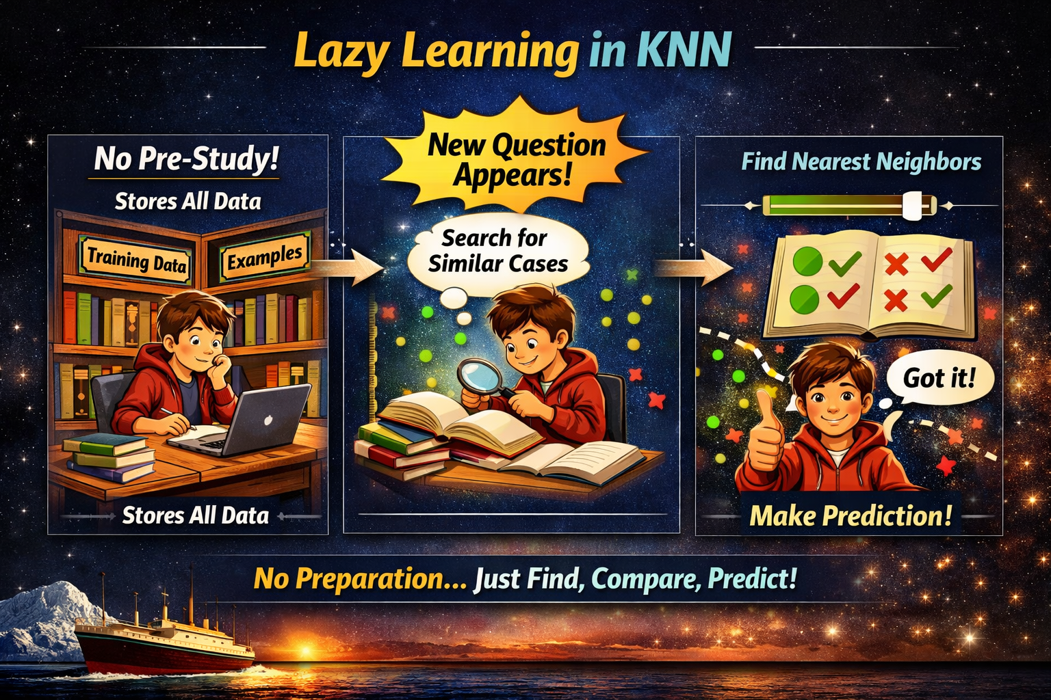
KNN ALGORITHM IN MACHINE LANGUAGE
Left Section – “No Pre‑Study!” The student keeps all examples (training data) without building a formula. → Emphasize that KNN stores data instead of learning rules.
Middle Section – “New Question Appears!” The student searches through the library for similar cases. → This shows how KNN looks up neighbors only when asked to predict.
Right Section – “Find Nearest Neighbors” The student compares examples, finds the closest ones, and makes a prediction. → Highlight that learning happens at prediction time, not before.

Slide 9
LAZY VERSUS LOGISTIC LEARNING
Key Comparison Table
Feature | Lazy Learning (KNN) | Eager Learning (Logistic Regression)
Training Phase | None | Model built before prediction
Prediction Time | Slow (search neighbors) | Fast (use learned model)
Memory Use | High | Low
Adaptability | Easy to update | Needs retraining
Example Analogy | Student who looks up answers | Student who memorizes formulas

Slide 10
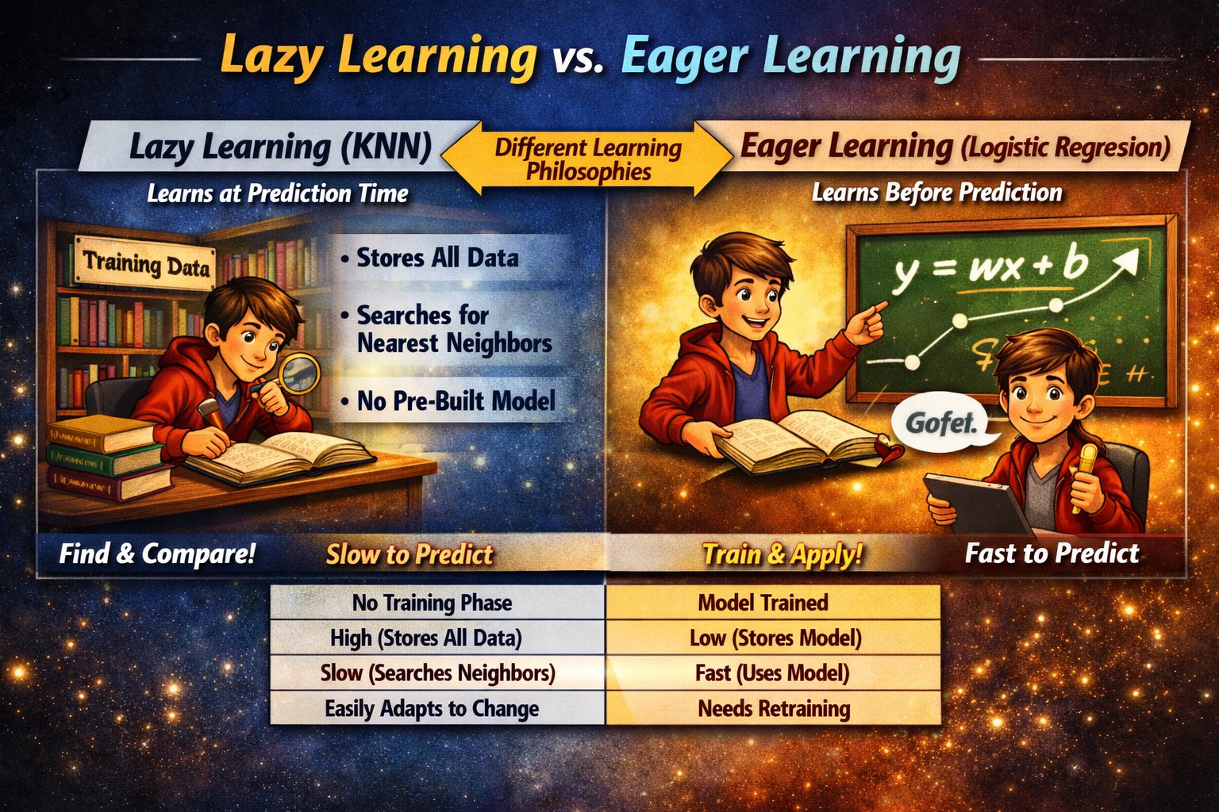
KNN ALGORITHM IN MACHINE LANGUAGE
Left Panel — Lazy Learning (KNN):
Learns at prediction time.
Stores all data, searches neighbors, no pre‑built model.
Analogy: student flipping through books during the exam.
Key point: flexible but slow to predict.
Right Panel — Eager Learning (Logistic Regression):
Learns before prediction.
Trains a model, fits parameters, applies learned equation.
Analogy: student who studies formulas before the exam.
Key point: fast predictions but needs retraining if data changes.
Comparison Table: Training → none vs. model built. Memory → high vs. low. Prediction speed → slow vs. fast. Adaptability → easy vs. retraining required.

Slide 11
KNN ALGORITHM IN MACHINE LANGUAGE
What Is Non‑Parametric Learning?
Non‑parametric learning refers to algorithms that do not assume a fixed mathematical form or number of parameters for the underlying data distribution. Instead, they adapt their complexity to the data itself — the more data you have, the more flexible the model becomes.
Key Idea
In parametric models (like Logistic Regression), you define a fixed number of parameters — e.g., weights and bias — and learn them from data.
In non‑parametric models (like KNN), the model structure grows with the dataset. There’s no fixed formula; predictions depend directly on stored examples.
Analogy for Students
Imagine two types of chefs:
Parametric Chef: Learns a fixed recipe — same ingredients, same steps every time.
Non‑Parametric Chef: Tastes each new ingredient and adjusts the recipe dynamically. KNN is that flexible chef — it adapts based on what’s available (the data points).

Slide 12
KNN ALGORITHM IN MACHINE LANGUAGE
Examples of Non‑Parametric Algorithms
Algorithm | Description
K‑Nearest Neighbors (KNN) | Predicts based on proximity to stored data points.
Decision Trees | Splits data dynamically based on feature values.
Kernel Density Estimation (KDE) | Estimates probability distributions without assuming shape.
Support Vector Machines (with non‑linear kernels) | Uses data‑driven boundaries instead of fixed equations.
In the Titanic dataset:
A parametric model (Logistic Regression) learns fixed coefficients for Age, Fare, and Class.
A non‑parametric model (KNN) simply stores all passengers and predicts survival by comparing the new passenger to similar ones — no fixed formula, just data‑driven reasoning.

Slide 13
KNN ALGORITHM IN MACHINE LANGUAGE
Examples of Non‑Parametric Algorithms
Algorithm | Description
K‑Nearest Neighbors (KNN) | Predicts based on proximity to stored data points.
Decision Trees | Splits data dynamically based on feature values.
Kernel Density Estimation (KDE) | Estimates probability distributions without assuming shape.
Support Vector Machines (with non‑linear kernels) | Uses data‑driven boundaries instead of fixed equations.
In the Titanic dataset:
A parametric model (Logistic Regression) learns fixed coefficients for Age, Fare, and Class.
A non‑parametric model (KNN) simply stores all passengers and predicts survival by comparing the new passenger to similar ones — no fixed formula, just data‑driven reasoning.

Slide 14
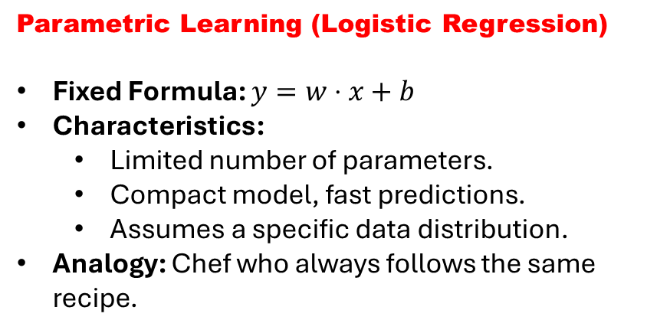
KNN ALGORITHM IN MACHINE LANGUAGE
Comparison Table
Feature | Parametric | Non‑Parametric
Model Form | Fixed equation | Flexible, data‑driven
Training | Learns parameters | Stores examples
Prediction Speed | Fast | Slower (search neighbors)
Memory Use | Low | High
Adaptability | Limited | High
Parametric Learning (Logistic Regression)
Fixed Formula: $y=w⋅x+b$
Characteristics:
Limited number of parameters.
Compact model, fast predictions.
Assumes a specific data distribution.
Analogy: Chef who always follows the same recipe.
Non‑Parametric Learning (KNN)
No Fixed Formula: Predictions depend directly on stored data.
Characteristics:
Complexity grows with dataset size.
Flexible, adapts to data patterns.
No assumptions about distribution.
Analogy: Chef who tastes and adjusts ingredients each time.

Slide 15
KNN ALGORITHM IN MACHINE LANGUAGE
How Does K-Nearest Neighbors Algorithm Work?
K-nearest neighbors (KNN) algorithm uses 'feature similarity' to predict the values of new datapoints which further means that the new data point will be assigned a value based on how closely it matches the points in the training set.
Step 1 − For implementing any algorithm, we need dataset. So during the first step of KNN, we must load the training as well as test data.
Step 2 − Next, we need to choose the value of K i.e. the nearest data points. K can be any integer.

Slide 16
KNN ALGORITHM IN MACHINE LANGUAGE
How Does K-Nearest Neighbors Algorithm Work?
K-nearest neighbors (KNN) algorithm uses 'feature similarity' to predict the values of new datapoints which further means that the new data point will be assigned a value based on how closely it matches the points in the training set.
Step 3 − For each point in the test data do the following −
3.1 − Calculate the distance between test data and each row of training data with the help of any of the method namely: Euclidean, Manhattan or Hamming distance. The most commonly used method to calculate distance is Euclidean.
3.2 − Now, based on the distance value, sort them in ascending order.
3.3 − Next, it will choose the top K rows from the sorted array.
3.4 − Now, it will assign a class to the test point based on most frequent class of these rows.
Step 4 − End

Slide 17
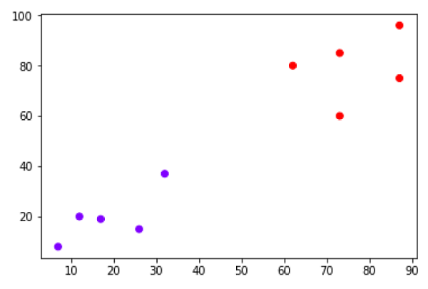
KNN ALGORITHM IN MACHINE LANGUAGE
Example
The following is an example to understand the concept of K and working of KNN algorithm
Suppose we have a dataset which can be plotted as follows

Slide 18
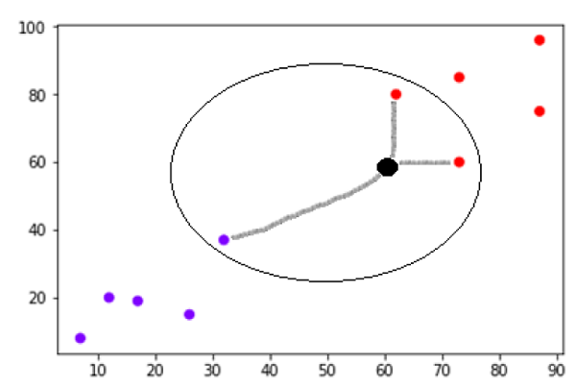
KNN ALGORITHM IN MACHINE LANGUAGE
Example
The following is an example to understand the concept of K and working of KNN algorithm
Now, we need to classify new data point with black dot (at point 60,60) into blue or red class. We are assuming K = 3 i.e. it would find three nearest data points. It is shown in the diagram −
We can see in the above diagram the three nearest neighbors of the data point with black dot. Among those three, two of them lies in Red class hence the black dot will also be assigned in red class.

Slide 19
KNN ALGORITHM IN MACHINE LANGUAGE
Building a K Nearest Neighbors Model
Calculate distances − Once the data is normalized, the KNN algorithm calculates the distances between the test data point and each data point in the training set.
Select k-nearest neighbors − The KNN algorithm selects the k-nearest neighbors based on the distances calculated in the previous step.
Make a prediction − For classification problems, the KNN algorithm assigns the test data point to the class that appears most frequently among the k-nearest neighbors. For regression problems, the KNN algorithm assigns the test data point the average of the k-nearest neighbors' values.
Evaluate performance − Finally, the KNN algorithm's performance is evaluated using various metrics such as accuracy, precision, recall, and F1-score.
We can follow the below steps to build a KNN model
Load the data − The first step is to load the dataset into memory. This can be done using various libraries such as pandas or numpy.
Split the data − The next step is to split the data into training and test sets. The training set is used to train the KNN algorithm, while the test set is used to evaluate its performance.
Normalize the data − Before training the KNN algorithm, it is essential to normalize the data to ensure that each feature contributes equally to the distance metric calculation.

Slide 20
KNN ALGORITHM IN MACHINE LANGUAGE
Pros & Cons of KNN
Pros
It is very simple algorithm to understand and interpret.
It is very useful for nonlinear data because there is no assumption about data in this algorithm.
It is a versatile algorithm as we can use it for classification as well as regression.
It has relatively high accuracy but there are much better supervised learning models than KNN.
Cons
It is computationally a bit expensive algorithm because it stores all the training data.
High memory storage required as compared to other supervised learning algorithms.
Prediction is slow in case of big N.
It is very sensitive to the scale of data as well as irrelevant features.

Slide 21
KNN ALGORITHM IN MACHINE LANGUAGE
Applications of KNN
The following are some of the areas in which KNN can be applied successfully −
Banking System
KNN can be used in banking system to predict weather an individual is fit for loan approval? Does that individual have the characteristics similar to the defaulters one?
Calculating Credit Ratings
KNN algorithms can be used to find an individual's credit rating by comparing with the persons having similar traits.
Politics
With the help of KNN algorithms, we can classify a potential voter into various classes like "Will Vote", "Will not Vote", "Will Vote to Party 'Congress', "Will Vote to Party 'BJP'.

Slide 22
KNN ALGORITHM IN MACHINE LANGUAGE
Although K-Means and K-Nearest Neighbors (KNN) share the letter k and use distance metrics, they solve fundamentally different problems and operate in distinct ways.
K-Means is an unsupervised clustering algorithm. It works without labels, aiming to discover natural groupings in data. You choose the number of clusters (k), initialize centroids, assign points to the nearest centroid, update centroids as the mean of assigned points, and repeat until convergence. The output is cluster assignments and centroid positions. It’s used for tasks like customer segmentation, image compression, and anomaly detection.
KNN is a supervised learning algorithm for classification or regression. It stores labeled training data and, for a new point, finds the k nearest neighbors using a distance metric (e.g., Euclidean, Manhattan). For classification, it predicts the majority label; for regression, it predicts the average value. It’s used in image recognition, spam filtering, and recommendation systems.

Slide 23
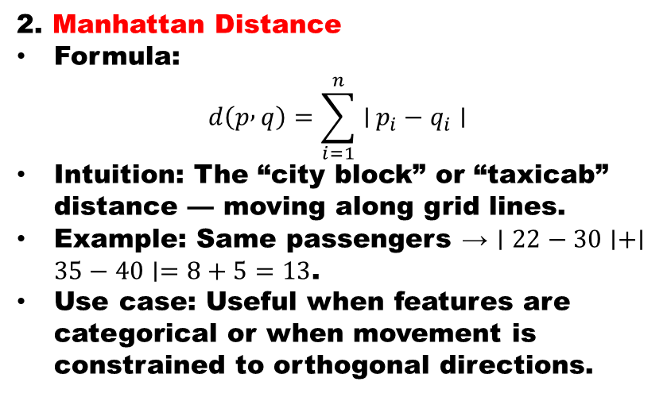
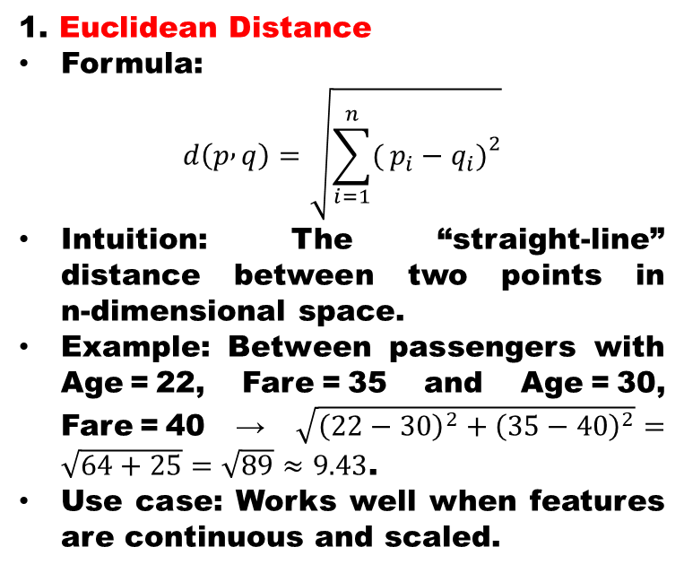
KNN ALGORITHM IN MACHINE LANGUAGE
The distance metrics are the mathematical backbone of KNN, and understanding them deeply helps students see why normalization and metric choice matter.
1. Euclidean Distance
Formula:
$$d\left(p , q\right)=\sqrt{\sum_{i=1}^{n}{(}\left.p_{i}−q_{i}{\left.)\right.}^{2}\right.}$$
Intuition: The “straight‑line” distance between two points in n‑dimensional space.
Example: Between passengers with Age = 22, Fare = 35 and Age = 30, Fare = 40 → $\sqrt{{\left(22−30\right)}^{2}+{\left(35−40\right)}^{2}}=\sqrt{64+25}=\sqrt{89}≈9.43$.
Use case: Works well when features are continuous and scaled.
2. Manhattan Distance
Formula:
$$d\left(p , q\right)=\sum_{i=1}^{n}{∣}p_{i}−q_{i}∣$$
Intuition: The “city block” or “taxicab” distance — moving along grid lines.
Example: Same passengers → $∣22−30∣+∣35−40∣=8+5=13$.
Use case: Useful when features are categorical or when movement is constrained to orthogonal directions.

Slide 24
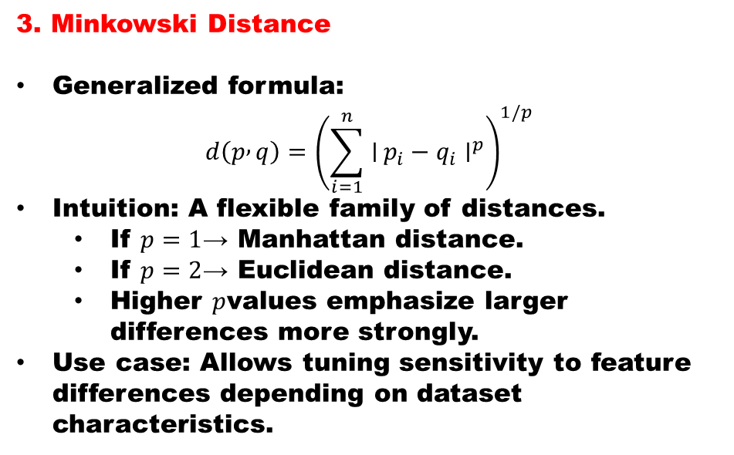
KNN ALGORITHM IN MACHINE LANGUAGE
The distance metrics are the mathematical backbone of KNN, and understanding them deeply helps students see why normalization and metric choice matter.
3. Minkowski Distance
Generalized formula:
$$d\left(p , q\right)={\left(\sum_{i=1}^{n}{∣}p_{i}−q_{i}∣^{p}\right)}^{1/p}$$
Intuition: A flexible family of distances.
If $p=1$→ Manhattan distance.
If $p=2$→ Euclidean distance.
Higher $p$values emphasize larger differences more strongly.
Use case: Allows tuning sensitivity to feature differences depending on dataset characteristics.
If you classify survival based on Age and Fare for The Titanic problem:
Euclidean favors smooth circular boundaries.
Manhattan creates sharper, grid‑like boundaries.
Minkowski lets you adjust between the two extremes.
This shows why choosing the right metric is critical for accuracy.

Slide 25
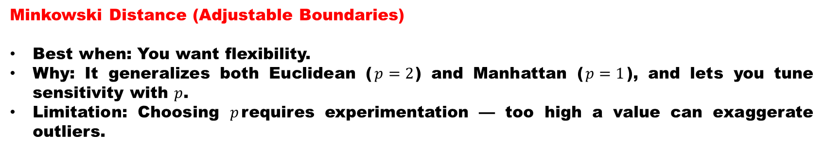
KNN ALGORITHM IN MACHINE LANGUAGE
Euclidean Distance (Circular Boundaries)
Best when: Features are continuous and properly scaled.
Why: It measures straight‑line similarity, so smooth circular neighborhoods make sense if Age and Fare are normalized.
Limitation: If one feature has a much larger range (e.g., Fare vs. Age), Euclidean can be skewed unless you scale.
Manhattan Distance (Grid‑like Boundaries)
Best when: Features are categorical or when movement is constrained to orthogonal axes.
Why: It adds absolute differences, so boundaries look like diamonds.
Limitation: Less natural for continuous features like Age and Fare, unless the dataset has strong axis‑aligned patterns.
Minkowski Distance (Adjustable Boundaries)
Best when: You want flexibility.
Why: It generalizes both Euclidean ($p=2$) and Manhattan ($p=1$), and lets you tune sensitivity with $p$.
Limitation: Choosing $p$requires experimentation — too high a value can exaggerate outliers.

Slide 26
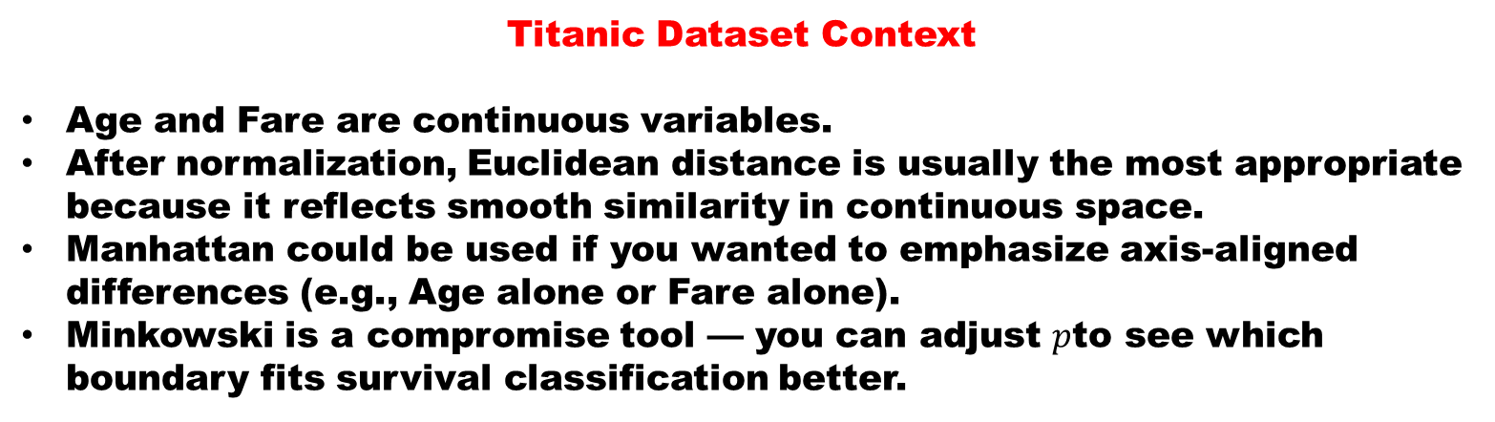
KNN ALGORITHM IN MACHINE LANGUAGE
Titanic Dataset Context
Age and Fare are continuous variables.
After normalization, Euclidean distance is usually the most appropriate because it reflects smooth similarity in continuous space.
Manhattan could be used if you wanted to emphasize axis‑aligned differences (e.g., Age alone or Fare alone).
Minkowski is a compromise tool — you can adjust $p$to see which boundary fits survival classification better.
“There isn’t a single ‘right’ metric — the choice depends on your data. For Titanic’s Age and Fare, Euclidean is most natural after scaling, but Minkowski lets you experiment between Euclidean and Manhattan to see which captures survival patterns better.”

Slide 27
KNN ALGORITHM IN MACHINE LANGUAGE
import numpy as np
from collections import Counter
# Function to calculate Euclidean distance
def euclidean_distance(point1, point2):
return np.sqrt(np.sum((np.array(point1) - np.array(point2))**2))
# KNN prediction function
def knn_predict(training_data, training_labels, test_point, k):
distances = []
for i in range(len(training_data)):
dist = euclidean_distance(test_point, training_data[i])
distances.append((dist, training_labels[i]))
distances.sort(key=lambda x: x[0])
k_nearest_labels = [label for _, label in distances[:k]]
return Counter(k_nearest_labels).most_common(1)[0][0]
# Example usage
training_data = [[1, 2], [2, 3], [3, 4], [6, 7], [7, 8]]
training_labels = ['A', 'A', 'A', 'B', 'B']
test_point = [4, 5]
k = 3
prediction = knn_predict(training_data, training_labels, test_point, k)
print(prediction) # Output: 'A'
simple implementation of KNN from scratch

Slide 28
KNN ALGORITHM IN MACHINE LANGUAGE
Choosing K Wisely
The value of K is critical:
Small K (like 1 or 3) → highly sensitive to noise, can overfit.
Large K → smoother decision boundaries, but may dilute local patterns.
A practical tip: use cross‑validation to select the best K for your dataset.
Feature Scaling
KNN relies on distance metrics, so features must be on comparable scales.
Without normalization, a feature like Fare (0–500) can dominate Age (0–80).
Standardization (z‑score) or Min‑Max scaling ensures fair contribution of all features.
Titanic example: scaling Age and Fare before applying Euclidean distance improves classification accuracy.
Weighted KNN
Instead of treating all neighbors equally, you can weight them by distance.
Closer neighbors have more influence than farther ones.
This often improves performance, especially when data density varies.
Teaching cue: Compare predictions with uniform vs. distance‑weighted voting.

Slide 29
KNN ALGORITHM IN MACHINE LANGUAGE
Beyond Basics
KNN can be extended to regression (predicting continuous values).
It’s also used in recommendation systems (finding “nearest” users/items).
In high‑dimensional data, KNN struggles (curse of dimensionality) — a good segue into dimensionality reduction techniques like PCA.

Slide 30
KNN ALGORITHM IN MACHINE LANGUAGE
1. Collect Solar Flare Data
Start Here
Gather observational data from satellites and instruments.
Use datasets from GOES, Aditya-L1 SoLEXS, or Solar Orbiter
Record features such as X-ray flux, duration, peak intensity, and spectral bands
Label events by class (C, M, X)
2. Preprocess and Normalize Features
Prepare the data so distance metrics are meaningful.
Handle missing values and remove noise
Normalize features (e.g., scale flux and duration)
Encode categorical labels (flare classes)
3. Choose Distance Metric
Select how similarity between flare events is measured.
Euclidean for continuous flux and duration
Manhattan if emphasizing axis-aligned differences
Minkowski for adjustable sensitivity

Slide 31
KNN ALGORITHM IN MACHINE LANGUAGE
4. Select K Value
Determine the number of neighbors to consider.
Use cross-validation to find optimal K
Small K → sensitive to noise
Larger K → smoother classification boundaries
5. Train and Predict
Apply KNN to classify new solar flare events.
Store all training flare examples
For a new flare, compute distances to all stored events
Predict class based on majority vote of nearest neighbors
6. Evaluate Performance
Recommended
Assess how well the model classifies solar flares.
Use metrics like accuracy, precision, recall, and F1-score
Compare results with parametric models (e.g., Logistic Regression)
Adjust K or distance metric if needed
This is an example in
Space Science

Slide 32
KNN ALGORITHM IN MACHINE LANGUAGE
As we close this session, it is clear that the K‑Nearest Neighbors algorithm is more than just a simple classifier — it is a powerful reminder that proximity and similarity often shape outcomes. Whether we explored distance metrics, lazy learning, or the Titanic dataset, each example highlighted how KNN adapts flexibly to data without assuming rigid formulas. This adaptability makes it an essential tool for students to understand, not only as a machine learning technique but also as a way of thinking about relationships in data.
At the same time, we must recognize its trade‑offs: KNN’s strength lies in its simplicity and intuition, but it demands careful preprocessing, scaling, and thoughtful choice of distance metrics. The lesson here is that no algorithm is universally perfect — the “right” approach depends on the nature of the problem and the data at hand. By comparing KNN with eager, parametric models like Logistic Regression, we see how different philosophies of learning can complement each other in practice.
Ultimately, KNN teaches us a broader truth: in data science, as in life, context and closeness matter. The neighbors we choose — whether in algorithms or in communities — shape the predictions we make and the futures we build. With this perspective, I encourage you to carry forward both the technical insights and the intuitive wisdom of KNN into your own explorations.

Slide 33

“Before we conclude, let’s take a moment for your questions. We’ve explored lazy learning, distance metrics, and even how KNN can classify solar flares — but every insight becomes stronger when we discuss it together. So, if there’s a concept you’d like clarified, a topic you’d like reviewed, or a new idea you’d like to explore, now’s the time. Remember, curiosity is the real engine of learning — and today’s questions might spark tomorrow’s discoveries.”

